Slide 1
Customer Data Analysis
Internship Project June-2026
PRDA-05-Customer Data Analysis
Submitted By: Varun Vinay Gokral
Tools Used: SQL | Power Bi | Power Query | DAX
Dataset Source: MySQL Database(99,457 Records)

Slide 2
Project Objective: This Project Aims To Analyze Retail Customer Transaction Data To Understand Customer Purchasing Behavior And Identify Business Insights. Using SQL And Power BI, The Data Was Analyzed To Evaluate Revenue Trends, Product Performance, Customer Demographics, And Payment Preferences.
Objectives
Extract customer transaction data from a MySQL database.
Clean and prepare the dataset using Power Query.
Analyze sales, revenue, and customer purchasing patterns.
Create interactive visualizations using Power BI.
Generate business insights and recommendations based on the analysis.

Slide 3
Dataset Overview: Dataset Source: MySQL Database Total Records: 99,457 Transactions
Dataset Includes
Customer ID
Customer Demographics (Age, Gender)
Product Categories
Quantity Purchased
Payment Methods
Shopping Mall Information
Transaction Details(Invoice No, Invoice Date)
The dataset was extracted from a MySQL database, cleaned using Power Query, and analyzed in Power BI to generate visualizations and business insights.

Slide 4
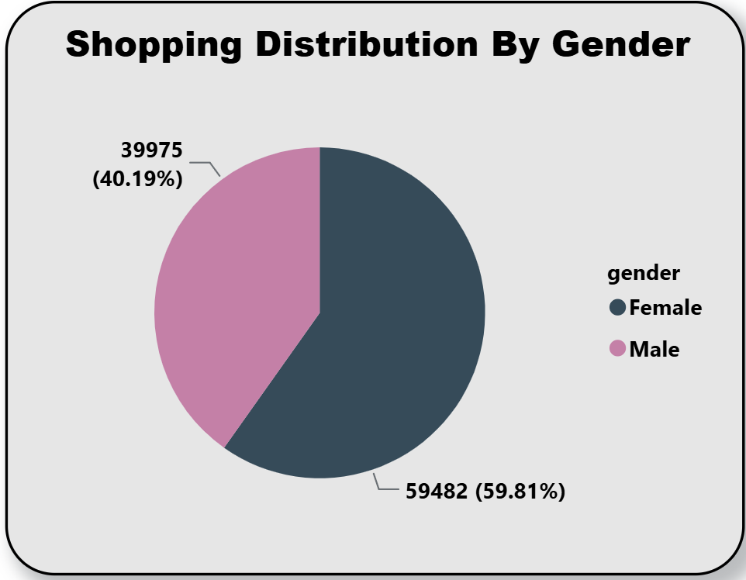
Shopping Distribution By Gender
Insights:
Female customers account for 59.81% of total customers.
Male customers account for 40.19% of total customers.
Female customers form the majority of the customer base.

Slide 5
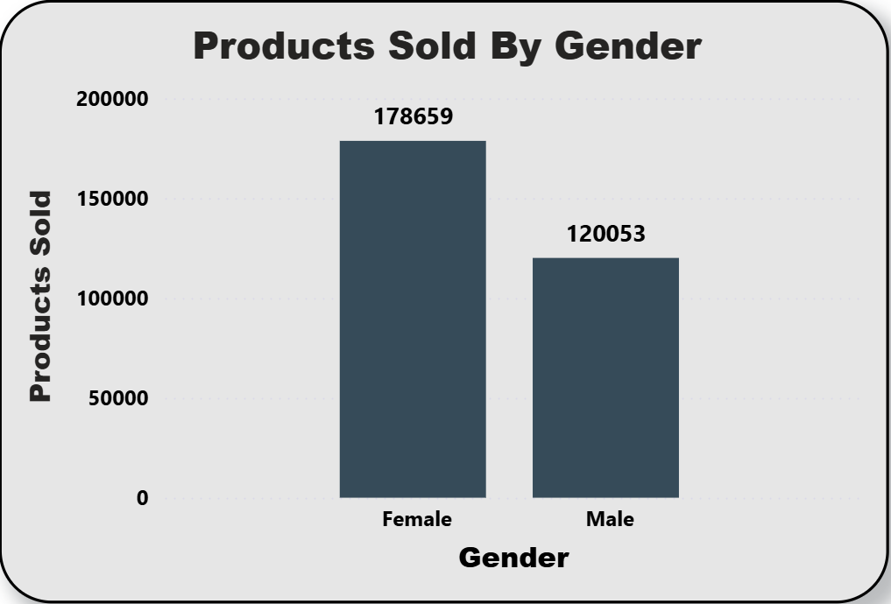
Products Sold By Gender
Insights:
Female customers purchased 178,659 products.
Male customers purchased 120,053 products.
Female customers purchased significantly more products than male customers.

Slide 6
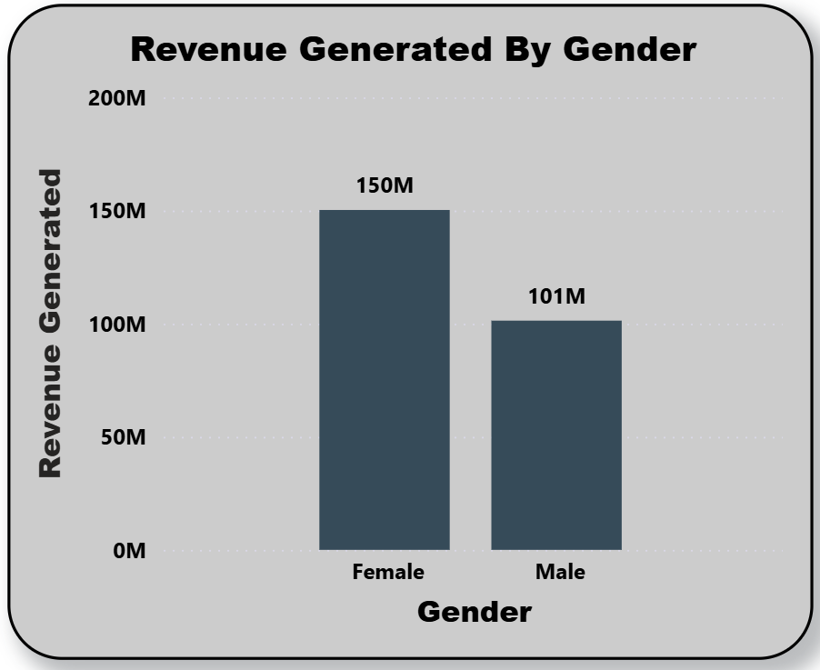
Revenue Generated By Gender
Insights:
Female customers generated approximately 150M in revenue.
Male customers generated approximately 101M in revenue.
Female customers contributed significantly more revenue than male customers.
This indicates that female customers have a higher overall purchasing value.

Slide 7
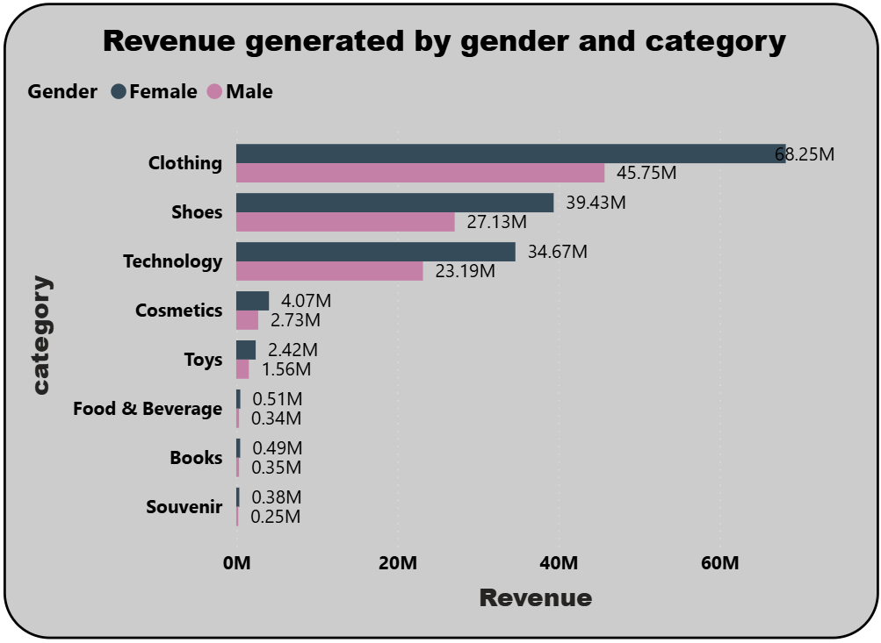
Revenue Generated By Gender And Category
Insights:
Clothing generated the highest revenue for both male and female customers.
Female customers generated higher revenue than male customers across all product categories.
Shoes and Technology were the second and third highest revenue-generating categories.
Books, Souvenirs, and Food & Beverage contributed the least revenue.

Slide 8
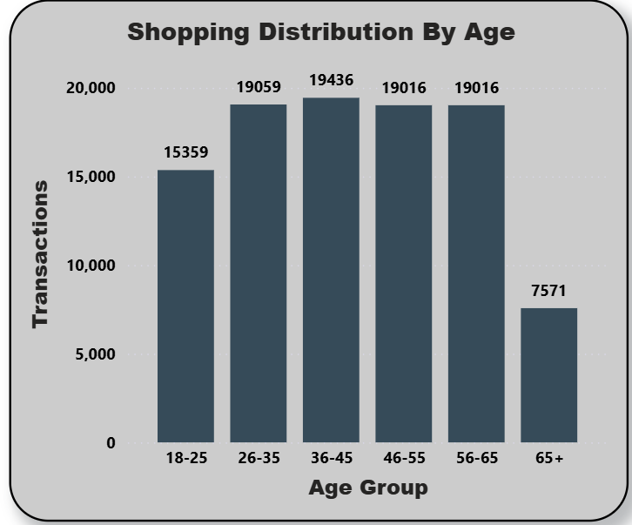
Shopping Distribution By Gender
Insights:
Customers aged 36–45 recorded the highest number of shopping transactions (19,436).
The 26–35, 46–55, and 56–65 age groups showed similar shopping activity (around 19,000 transactions each).
Customers aged 65+ recorded the lowest number of shopping transactions (7,571).
Shopping activity is highest among customers aged 26–65.

Slide 9
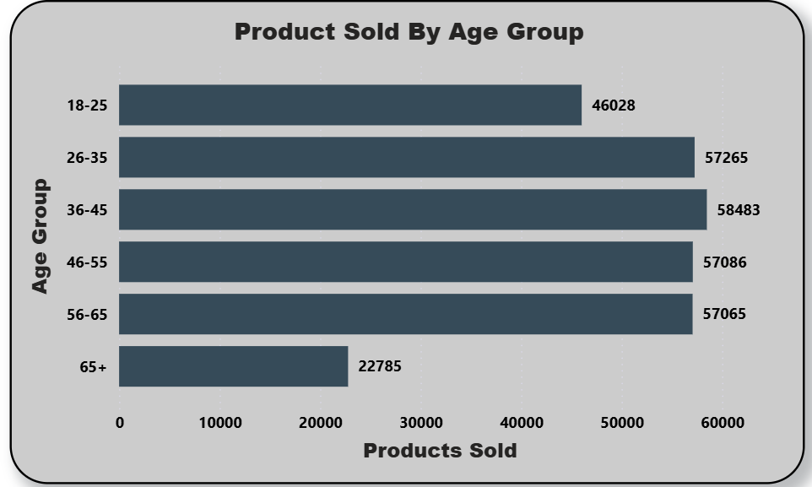
Products Sold By Age Group
Insights:
Customers aged 36–45 purchased the highest number of products (58,483).
The 26–35, 46–55, and 56–65 age groups also contributed significantly to product sales (around 57,000 products each).
Customers aged 65+ purchased the fewest products (22,785).
The majority of product sales came from customers between 26 and 65 years.

Slide 10
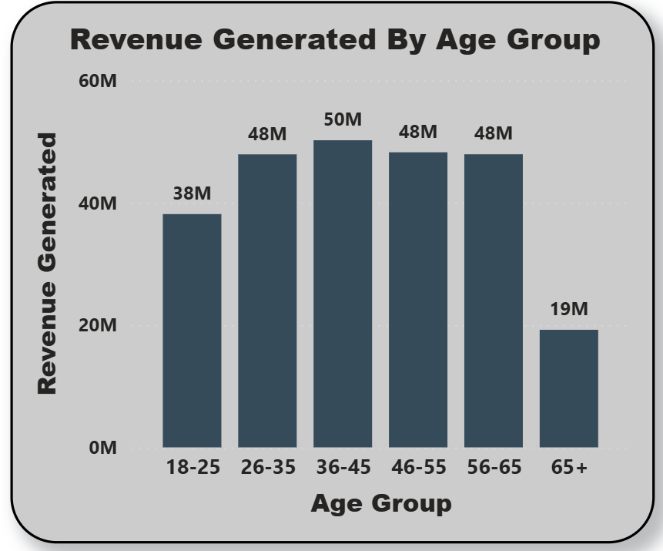
Revenue Generated By Age Group
Insights:
Customers aged 36–45 generated the highest revenue (50M)
.The 26–35, 46–55, and 56–65 age groups each generated approximately 48M in revenue.
Customers aged 65+ generated the lowest revenue (19M).
The 26–65 age group contributes the majority of total revenue.

Slide 11
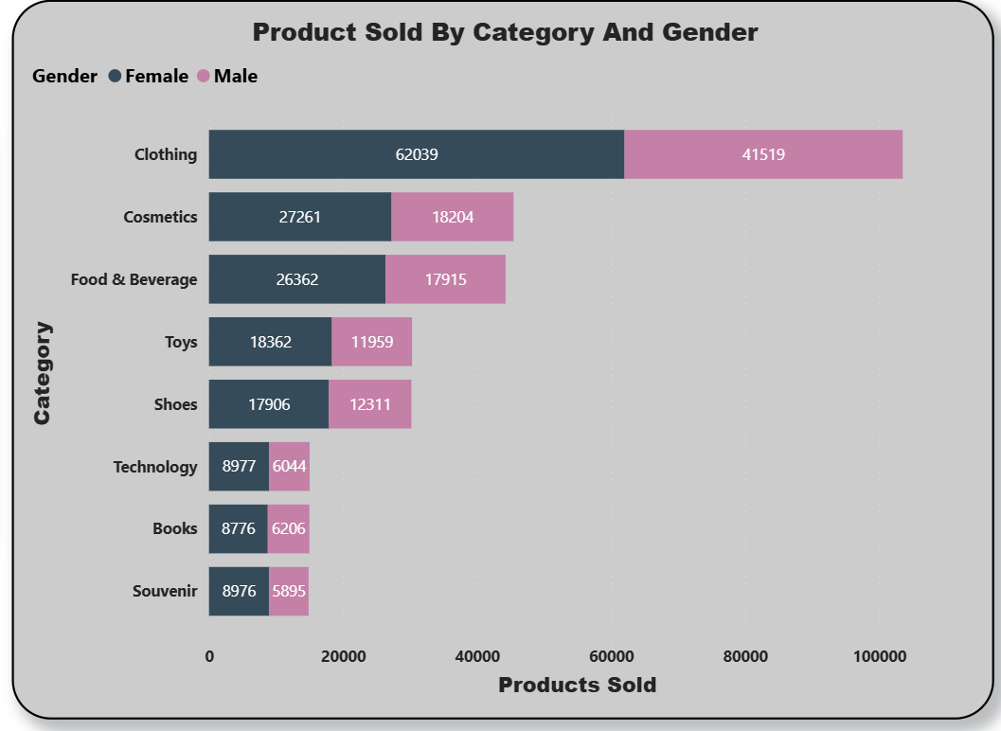
Products Sold By Category And Gender
Insights:
Clothing is the highest-selling category for both females (62,039) and males (41,519).
Female customers purchased more products than male customers across all product categories
Cosmetics and Food & Beverage are the next most purchased categories after Clothing.
Technology, Books, and Souvenirs recorded the lowest product sales.
Clothing should remain a key focus category, while lower-performing categories may require targeted promotions to increase sales

Slide 12
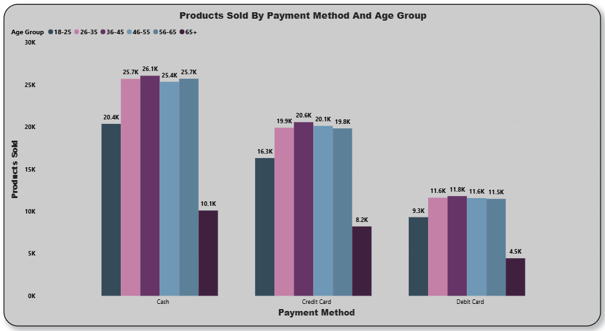
Products Sold By Payment And Age Group
Insights:
Cash is the most preferred payment method across all age groups.
Customers aged 36–45 recorded the highest number of cash purchases (26.1K).
Credit Card is the second most preferred payment method across all age groups.
Debit Card is the least used payment method overall.
Customers aged 65+ recorded the lowest number of purchases across all payment methods.

Slide 13
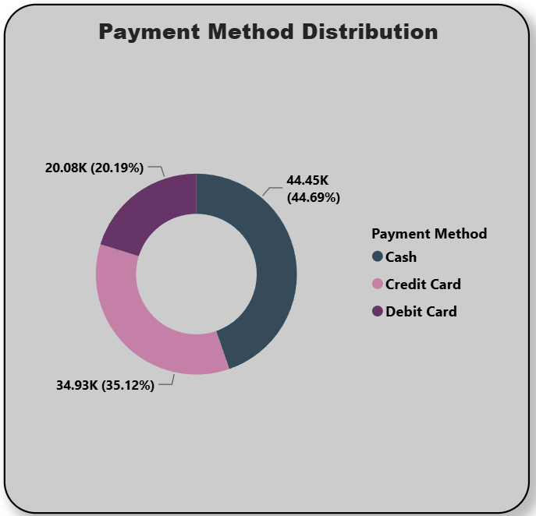
Payment Method Distribution
Insights:
Cash is the most frequently used payment method, accounting for 44.69% (44.45K) of all transactions
Credit Card accounts for 35.12% (34.93K) of total transactions.
Debit Card is the least preferred payment method, contributing 20.19% (20.08K) of transactions.
Customers show a clear preference for cash payments, followed by credit cards.
Businesses should continue supporting cash payments while promoting digital payment methods to increase adoption.

Slide 14
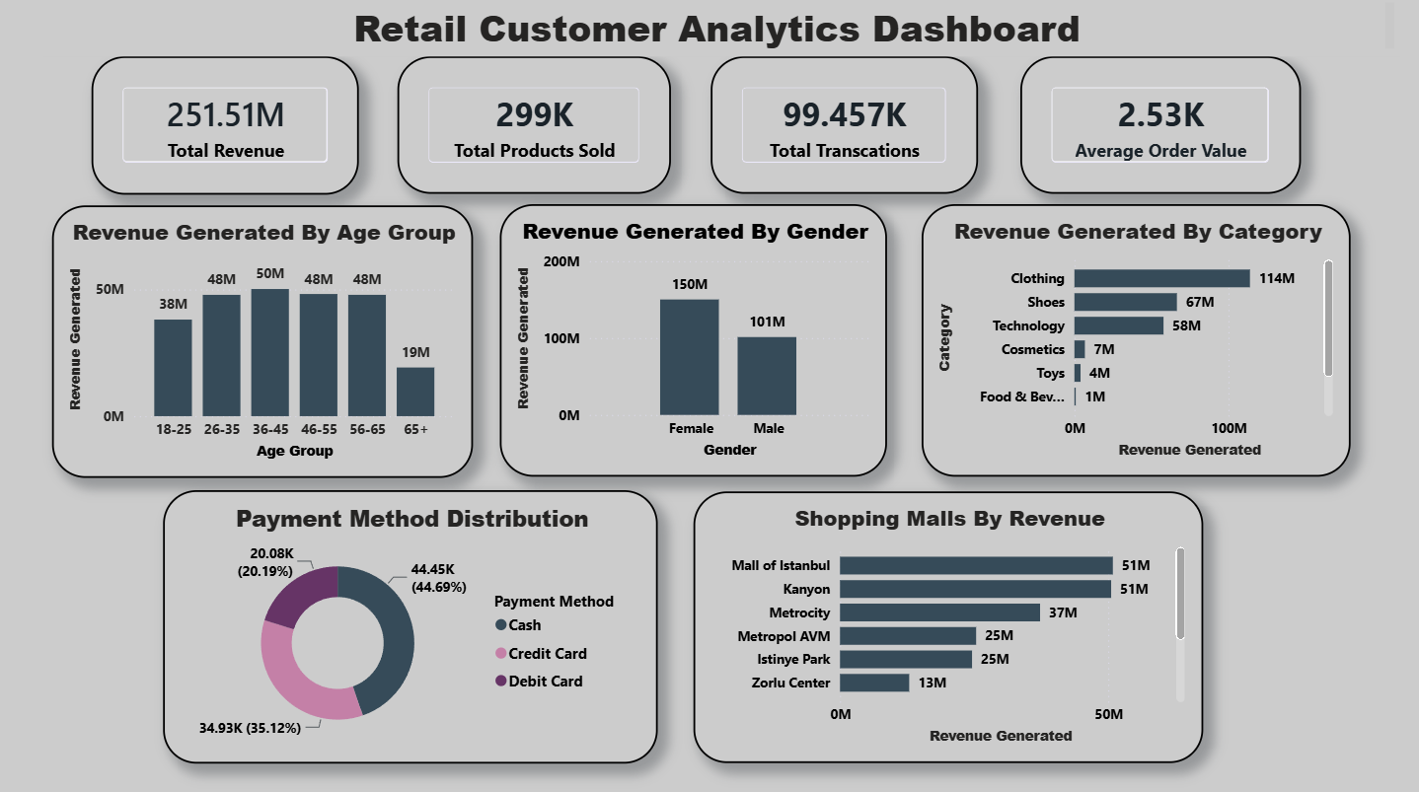

Slide 15
Overall Insights:
Total revenue generated is 251.51M from 99.46K transactions.
Female customers contribute more revenue and purchase more products than male customers.
Clothing is the highest revenue-generating product category.
Customers aged 36–65 contribute the highest revenue and sales.
Cash is the most preferred payment method, followed by Credit Card.
Mall of Istanbul and Kanyon are the top-performing shopping malls.
Recommendations:
Increase inventory and promotions for Clothing and other high-performing categories.
Focus marketing campaigns on the 36–65 age group.
Continue supporting cash payments while encouraging digital payments through offers.
Improve promotions for lower-performing categories such as Books and Souvenirs.
Analyze successful malls and replicate their strategies in lower-performing locations.

